Slide 1

Loan Calculator App: Making Loan Calculations Easy

Slide 2
What is Loan Calculator
A loan calculator is a tool that estimates monthly payments and total loan cost. Borrowers input loan details like loan amount, interest rate, and term, and the calculator computes monthly payments, total interest, and total cost. It helps compare loan options and choose one that fits the borrower's financial goals.

Slide 3
Historical Part of Loan Calculator
The history of loan calculators can be traced back to the early 1970s when the first handheld electronic calculators became commercially available. These early calculators were basic, with limited functionality and high price tags, making them accessible only to a small group of professionals.
Overall, loan calculators have come a long way since their inception, from basic handheld calculators to sophisticated online and mobile apps. They have become an essential tool for borrowers, helping them compare loan options and make informed financial decisions.

Slide 4
How It works
A loan calculator takes specific loan details, such as the loan amount, interest rate, and loan term, and uses a formula to calculate the estimated monthly payment and total cost of the loan. It helps borrowers compare loan options and choose the best one for their budget and financial goals
Loan amount: The total amount of money borrowed.
Interest rate: The annual percentage rate (APR) charged on the loan.
Loan term: The length of time over which the loan will be repaid, usually measured in years or months.

Slide 5
Now the main part
Loan Calculator will help to determine the payment schedule on a loan. Simply enter the loan amount, term and interest rate in the fields and calculate it. The Project is based on Jetpack Compose.

Slide 6
Technology Stack
Kotlin
Jetpack
Compose
Navigation
ViewModel
Lifecycle
Firebase
Performance Monitoring
Crashlytics
Analytics
Admob

Slide 7
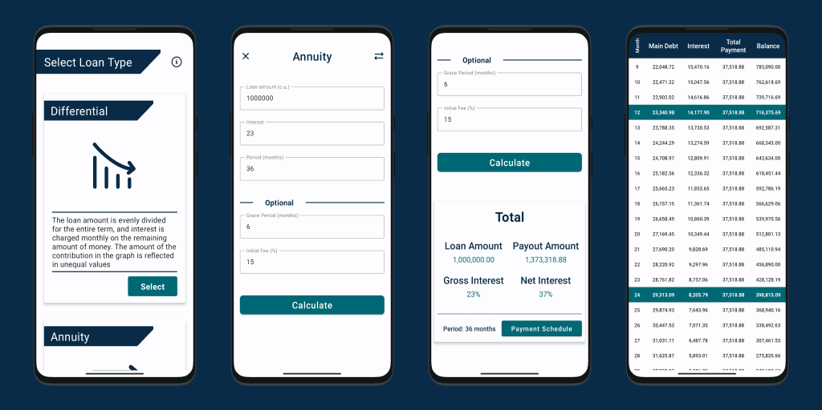
Preview

